Slide 1
MORTGAGE BALANCE FORECASTING ENGINE CASE STUDY
Problem 1
Anil Sener
7/5/2015

Slide 2
Assumptions of My Design
Requirement for distributed and parallel processing in two nodes
Disk I/O should be minimal
Multi-tenancy requirement for concurrent users
Assumption that Memory and CPU cores are redundantly available
Small Data Size for Macro Economic Data input
Huge Data Size for Mortgage Loan Portfolio Records
Requirement to handle simulation iterations

Slide 3
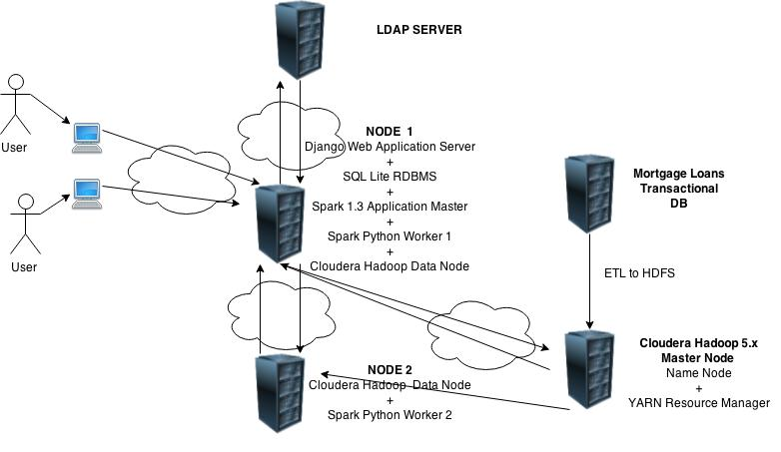
Proposed Technical Architecture

Slide 4
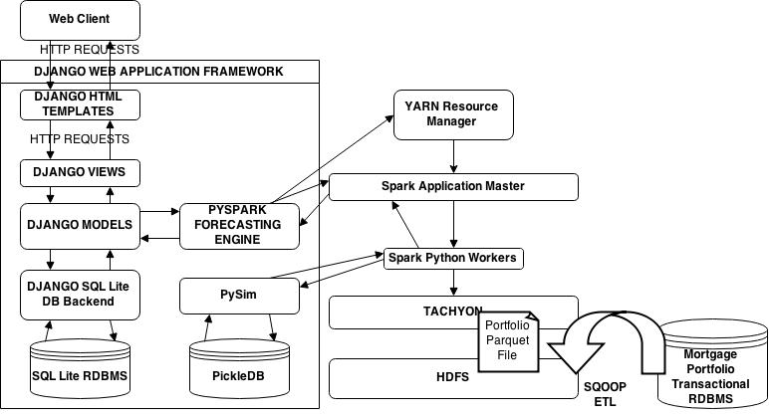
Proposed Application Design (1/2)

Slide 5
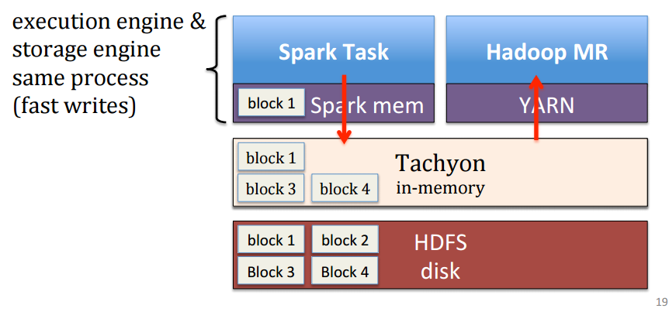
Proposed Application Design (2/2)

Slide 6
Rationales of My Design
Django Web Application Framework has a very scalable architecture to support multiple concurrent users with flexible integratability with different platforms. It is helpful to structure business logic according to MVC framework. It is easy to integrate with Pyspark in very mature version python 2.7.
Portfolio Data Sets can be stored in HDFS with an ETL process via Sqoop or other ETL applications. In the prototype I used regular text file because of the problems in my Hadoop. However mortgage portfolio records can be stored as parquet files with a schema which will improve disk I/O and usage. Spark can load them faster.
Spark might be used both in standalone mode or integrated with YARN, but since in our assumption the data size to be distribute is %50/50 it is very easy to make resource management by sparing Node1, 2 cpu for (1 for Django application and 1 for Spark Kernel Application) and 2GB redundantly we can equally distribute the resources in these servers. Usage of YARN is important in terms of coping with multi-tenancy requirement for concurrent usage YARN creates queues for Spark Application Master Requests and decides which server to create a Spark Application Master. (since you cannot run two spark contexts in a machine at the same time)
Since retrieving from disk will be the highest burden, it will be necessary to use Tachyon over HDFS to enable in memory data lineage of blocks to Spark memory, fault tolerance and RDD sharing between jobs.
I used SQLLite RDBMS because expected macro economical input is in a small scale and it integrates very well with Django Backend.
SimPy python package is used to execute the simulation facilities for the bonus problem handling and prioritizing the balance estimations with random value generation in this data size was a big problem and would increase code complexity. Since simpy is written in pure python it is performing very well. https://pythonhosted.org/SimPy/Tutorials/TheBank.htmlhttps://pythonhosted.org/SimPy/Tutorials/TheBank.html
Having Hadoop Name Node and Yarn RM in a separate machine is a good design practice an optional part of my design, however they can be also in one of the name nodes

Slide 7
THANK YOU!

